Slide 1


MEDIA MENGAJAR
BRIGHT AN ENGLISH
FOR SMP/MTs GRADE VIII

Slide 2
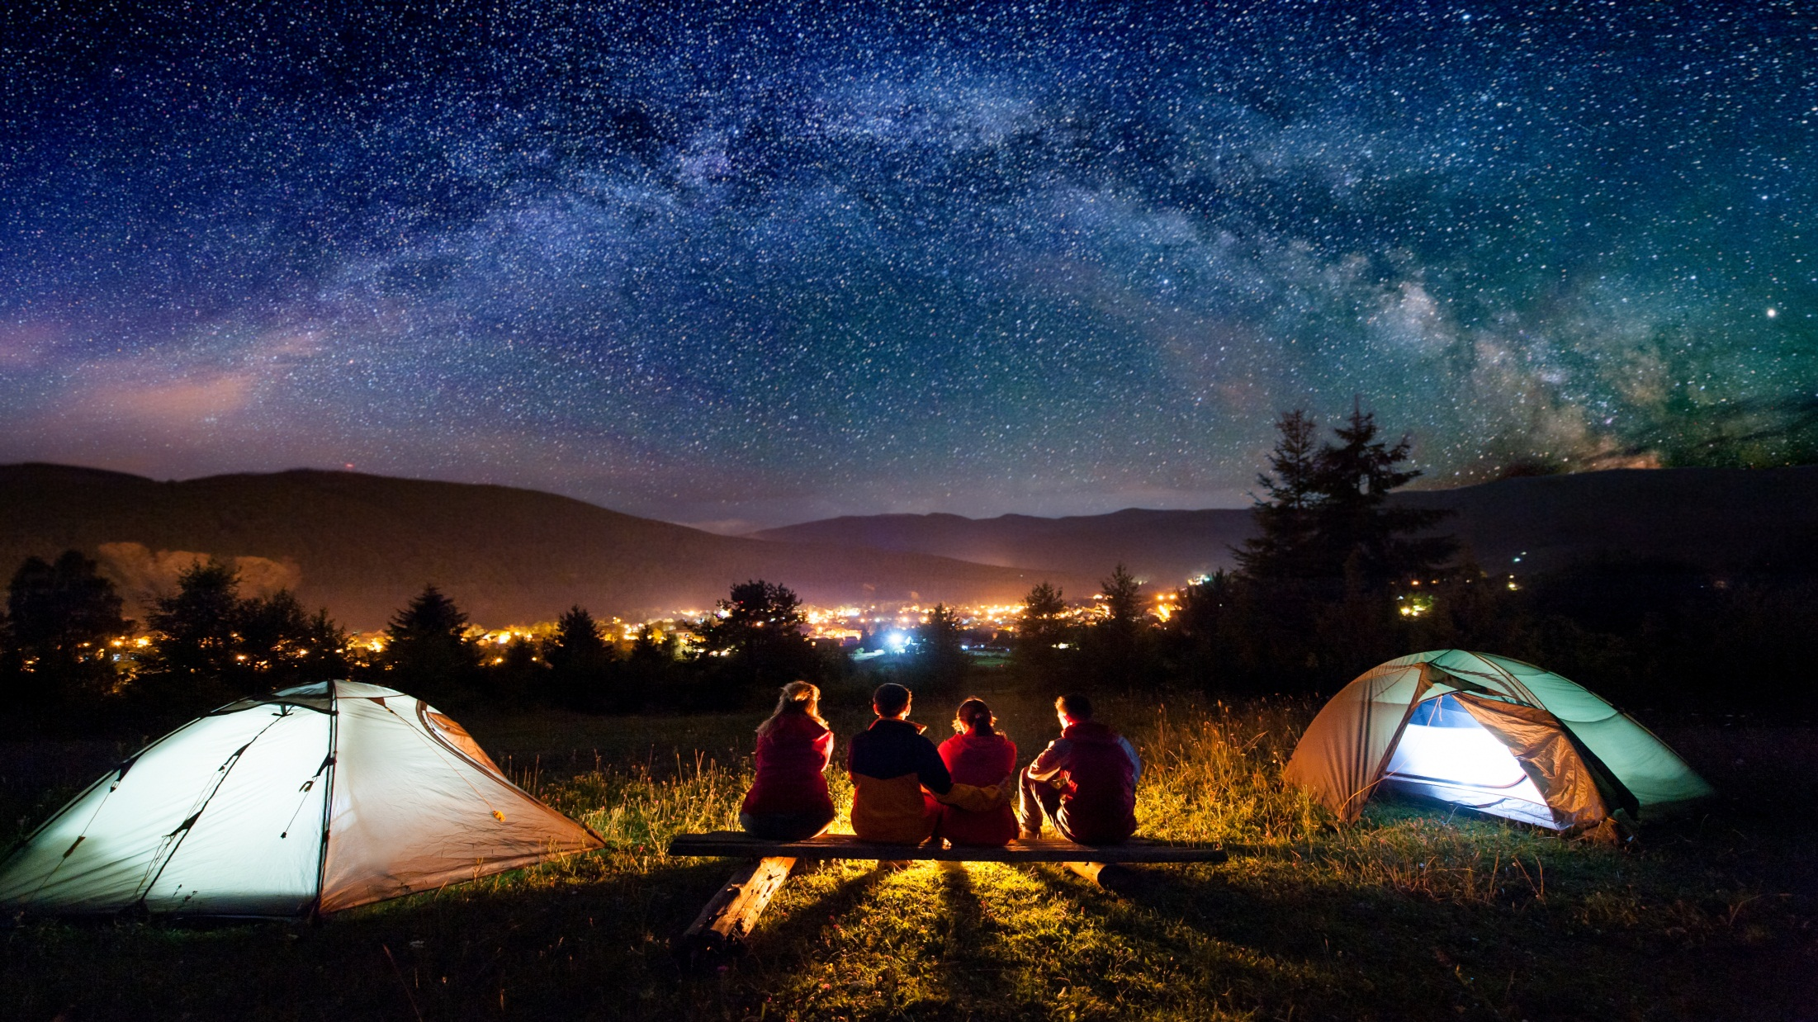
Chapter 4
We Went Camping Last Week
Notes:
Jika terdapat gambar cantumkan sumber gambar dgn ukuran font 10pt

Slide 3
A. ……….
In this chapter, we will learn to:
identify the simple past tense;
use the simple past tense in conversation;
talk about past events using the simple past tense;
identify regular and irregular verbs;
read and respond to texts relating to events that happened in the past;
communicate ideas and experiences through simple and organised paragraphs.

Slide 4


The Simple Past Tense
We use simple past tense to tell about past activities.

Slide 5
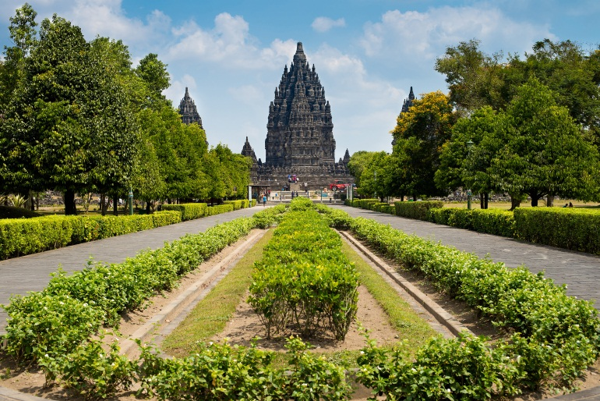
Listen to the recording. Practise the dialogue.
Salma : Hi, Basyir. How was your vacation?
Basyir : It was great.
Salma : Where did you go?
Basyir : I went to Yogyakarta.
Salma : Wow! What did you see?
Basyir : I saw some temples.
Salma : Did you like them?
Basyir : I loved them, especially Prambanan Temple. It was fantastic.
Salma : What did you buy?
Basyir : I bought this for you in the market.
Salma : Gee! Thanks. It’s cute.

Slide 6
Simple Present & Past Tense
Present | Past
The book is on the floor now. The children are in the park now I am sad now. | The book was on the table this morning. The children were at the beach yesterday. I was happy yesterday.
Regular Verbs
The past tense of regular verbs:
V + ed

Slide 7
Simple Present & Past Tense
Examples:
Affirmative (+)
1. He usually visits me on Saturday, but last week he visited me on Sunday.
2. The baby usually cries at midnight, but last night she cried at 1am.
Negatives (–)
1. Sarah always walks to school, but she didn’t walk to school yesterday.
2. The children always play football in the afternoon, but they didn’t play football this afternoon.

Slide 8
Simple Present & Past Tense
Questions (?)
1. Did Rick finish his job on time? Yes, he did.
2. Did the they study English yesterday? No, they didn’t. They studied maths.
Tips:
• If the verb ends in a consonant, add –ed. e.g. visit–visited, work–worked
• If the verb ends in –e, add –d. e.g. decide–decided, arrive–arrived
• If the verb ends in –y after a consonant, change the –y to –i and add –ed. e.g. cry–cried, try–tried

Slide 9
Irregular Verbs
Some verbs cannot be added with -ed to make the past form. Those verbs are called irregular verbs. You should memorise them.
Here are some of them.
Present | Past
teach | taught
catch | caught
buy | bought
bring | brought
fight | fought

Slide 10
GOOD JOB!

